Slide 2
👉 DAX has 2 worlds:
1. Measures (used in Power BI visuals)
Return single value
Example:
Total Employees = COUNT(HRData[EmployeeNumber])
2. DAX Queries (used in DAX Studio)
Must return tables
Use:
  EVALUATE
  ROW()
  SUMMARIZE()

Slide 3
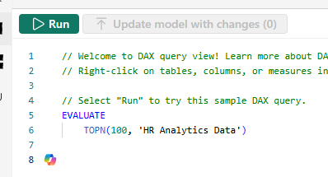
To run:

Slide 4
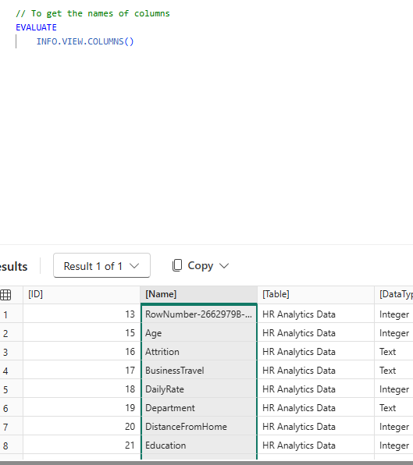

Slide 5
